Slide 1
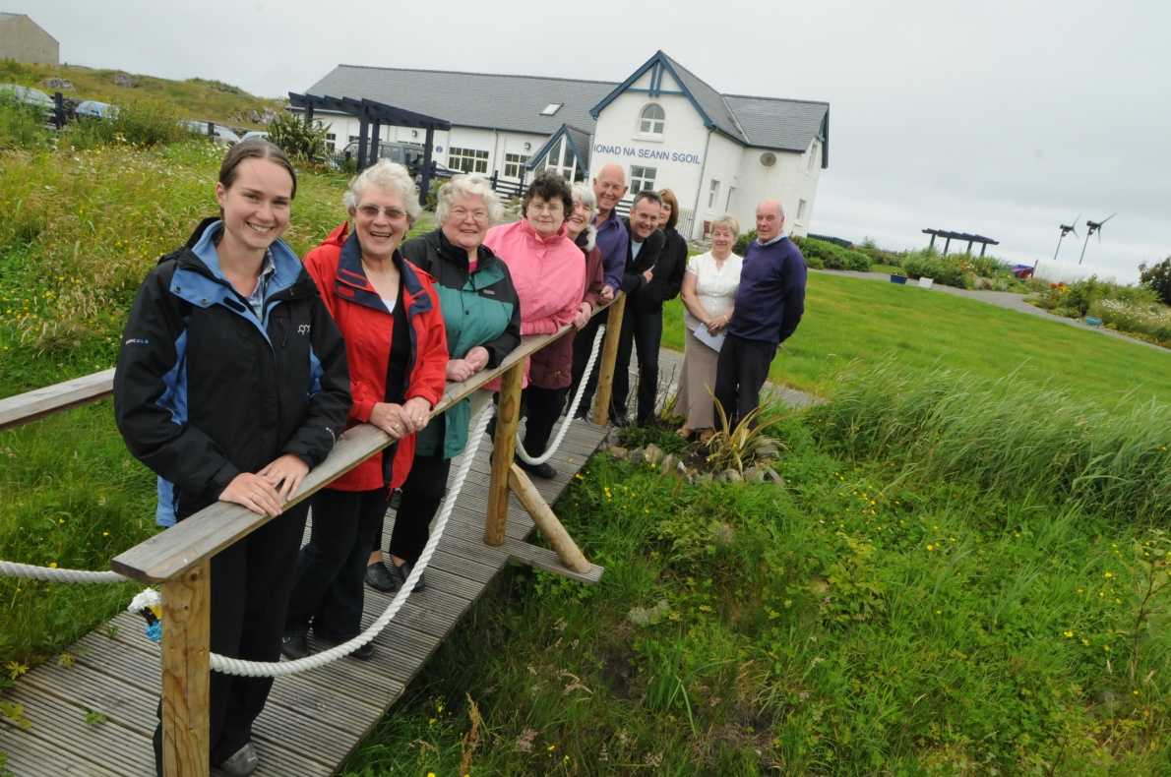
We build confidence, resilience and wealth at community level in Scotland through sustainable energy development
Notes:
DG Forum, CECG, CEC, ARC, KTP

Slide 2
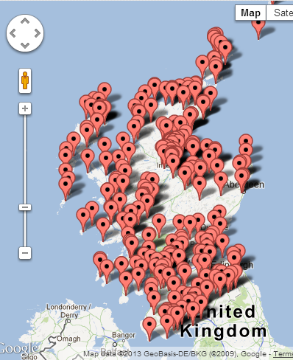
Independent Scottish charity with 25 staff across Scotland
Over 400 members, mostly non-profit distributing community groups
Supported over 600 community energy installations, totalling 37MW capacity
Our projects provide income and affordable energy worth over £5 million per year to local people

Slide 3
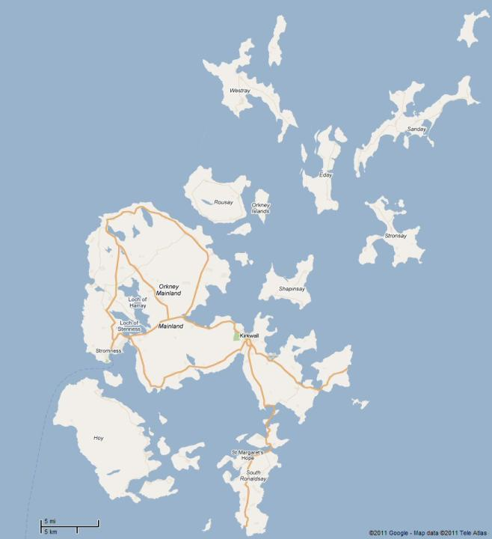
Orkney Large-scale Community Owned
Westray
(900kW)
Rousay
Egilsay
& Wyre
(900kW)
Sanday
(10% of 10MW)
Eday
(900kW)
Stronsay
(900kW)
OIC
(20% of 4.5MW)
Shapinsay
(900kW)
Hoy
(900kW)

Slide 4
Laying the foundations for locally powered ferries

Slide 5
Orkney’s renewable energy
High fossil fuel imports, despite more electricity being generated than the islands use and the grid can export
Year-round wind resource
Significant tidal energy
50MW of wind power installed, 15% community-owned
Active Network Management of distribution grid – power at zero marginal cost

Slide 6
The energy opportunity

Slide 7
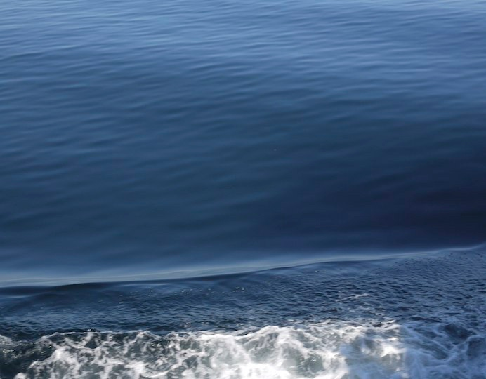
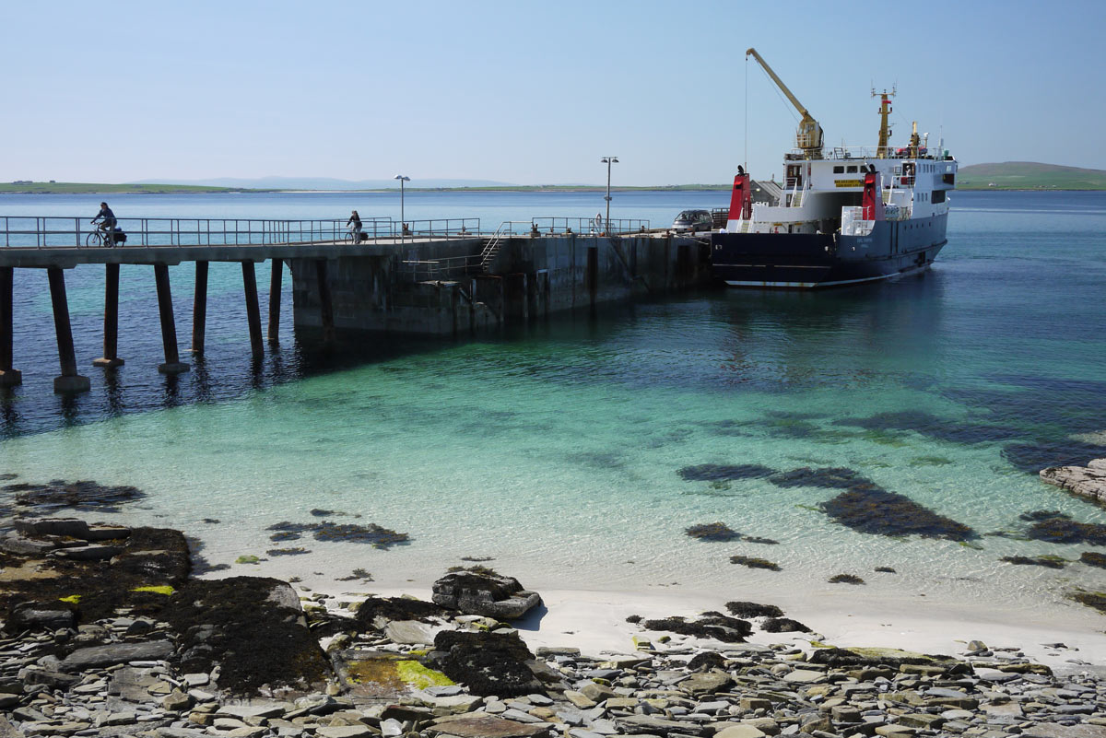
The energy opportunity
Marine transport
Year-round lifeline services to islands with curtailed wind turbines
Energy consumption up to 10MWh per day for each vessel
Vessels approaching end of life

Slide 8
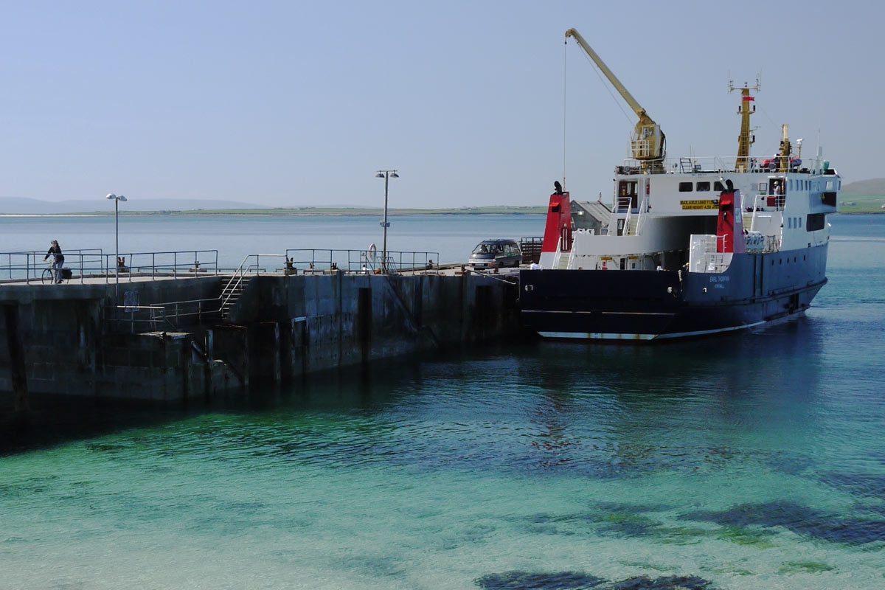
The energy opportunity
Marine transport
Year-round lifeline services to islands with curtailed wind turbines
Energy consumption up to 10MWh per day for each vessel
Vessels approaching end of life

Slide 9
The big ambition
Replace imported fossil fuel – marine diesel – with locally-sourced fuels or electricity
Retro-fitting
New vessels
Motive power
Auxiliary power
Cold-ironing

Slide 10
The reality check
Nobody expected it to be easy
Retro-fitting Insurance, class societies, lighter than air gases, discontinued engines, space, refit time
New vessels Suitability for conditions and routes
Motive power Lifeline services must be reliable
Auxiliary power Vessel power demand falling
Cold-ironing Already done

Slide 11
The realistic vision
Make it as easy as possible for renewables to be factored into replacement vessels
Energy supply chain
Crew and operators
Regulators and authorities
Local communities

Slide 12
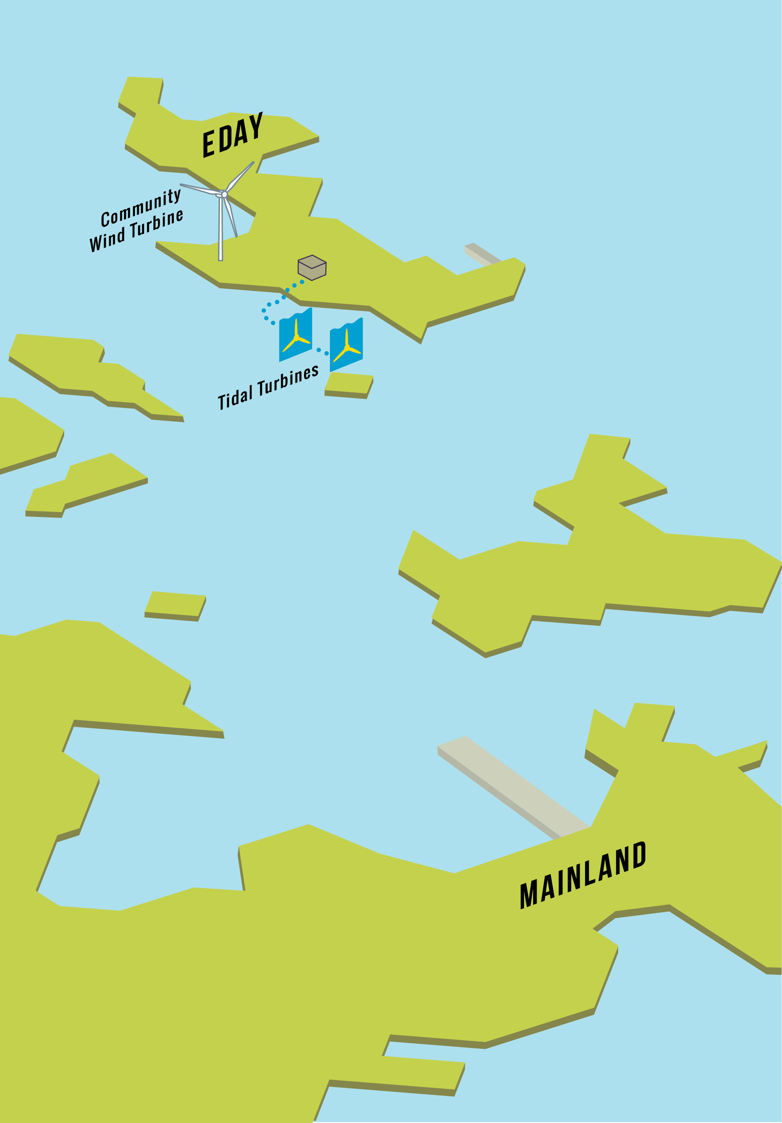
Hydrogen as a viable future fuel in Orkney
Hardware
Logistics
Authorisations
Training
Public engagement

Slide 13
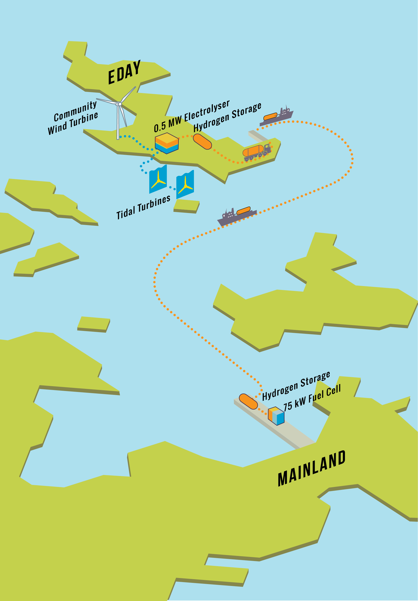
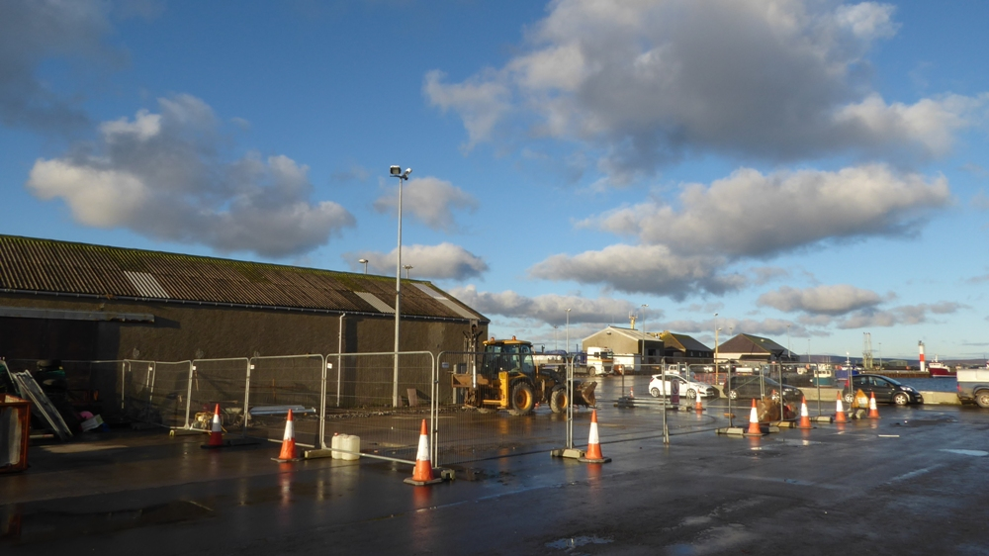
Hardware
500kW electrolyser, electricity from tidal or wind turbines
Three 250kg mobile hydrogen store units
Onshore fuel cell built to marine design standards
Electricity supply to harbour facilities
Heat to buildings

Slide 14
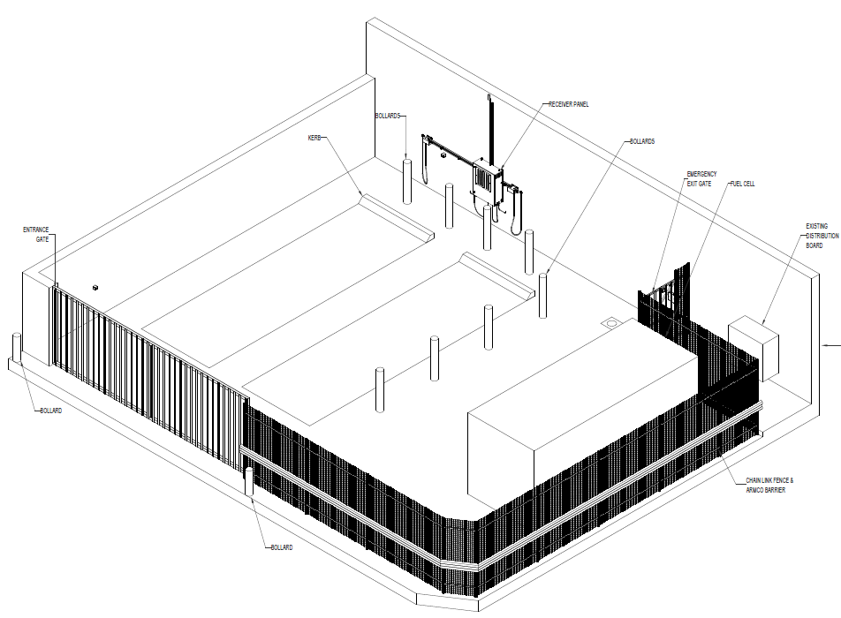
Hardware
500kW electrolyser , electricity from tidal or wind turbines
Three 250kg mobile hydrogen store units
Onshore fuel cell built to marine design standards
Electricity supply to harbour facilities

Slide 15
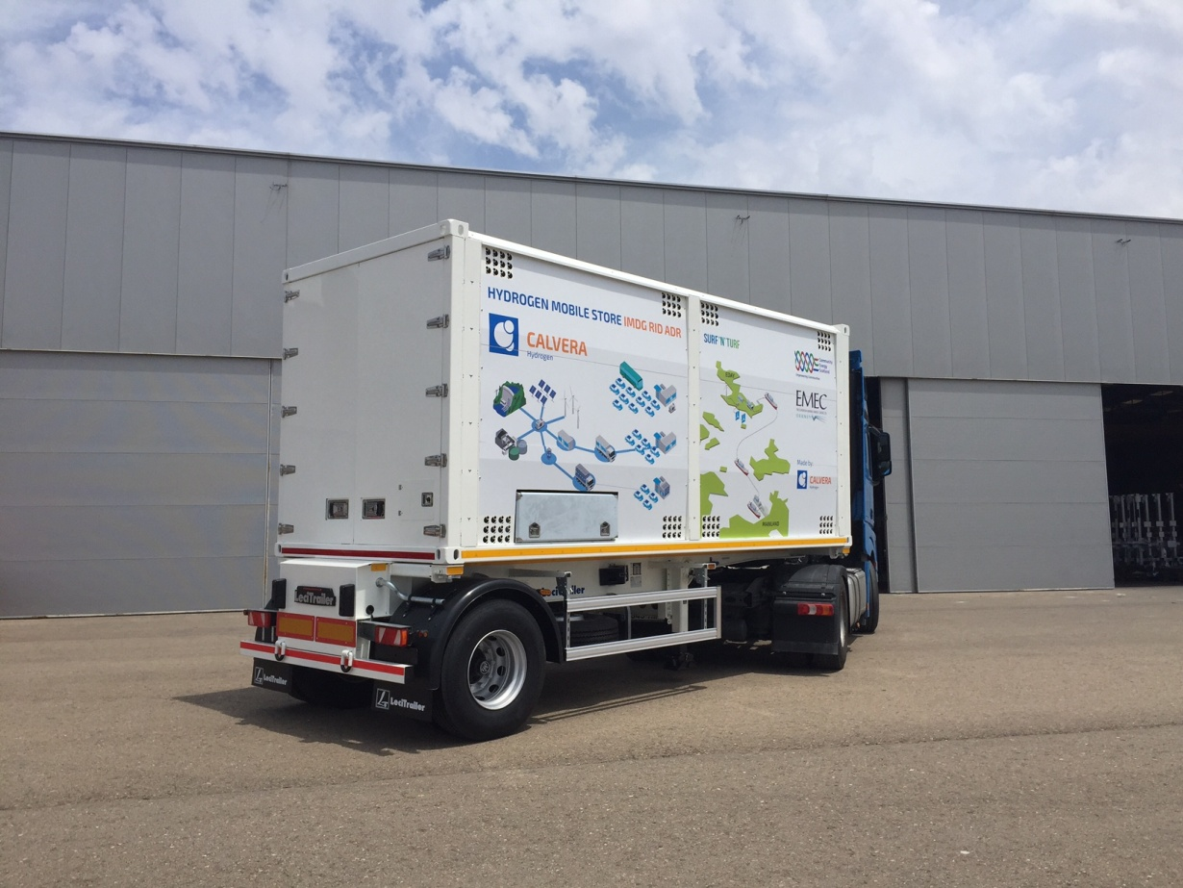
Logistics
Road and sea transit
Vehicle length and weight restrictions, plus ADR
IMO Dangerous Goods on public ferries
Timetables
Pipeline

Slide 16
Authorisations
Maritime & Coastguard Agency (UK Department of Transport)
Distribution Network Operator
Merchant Navy Training Board
Scottish Environment Protection Agency

Slide 17
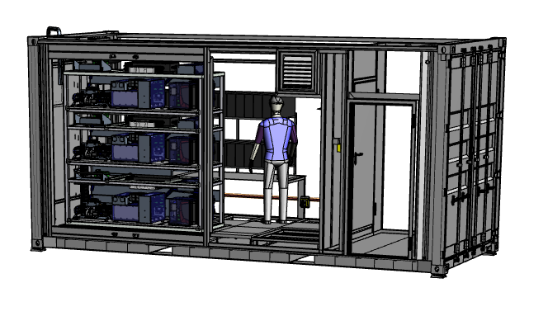
Training
Hydrogen handling and fire safety
Fuel cell operation
Public engagement
Access to lifeline service
Capacity and reliability
The Hindenburg

Slide 18
UK firsts
Wind and tidal energy combined storage system
Lightweight (composite) hydrogen store built to IMDG standards
Hydrogen familiarisation training for marine sector
And just maybe…
Sea-going hydrogen ro-ro ferry

Slide 19
Acknowledgements
The Scottish Government Local Energy Challenge Fund supports Surf ’n’ Turf
Five partners

Slide 21
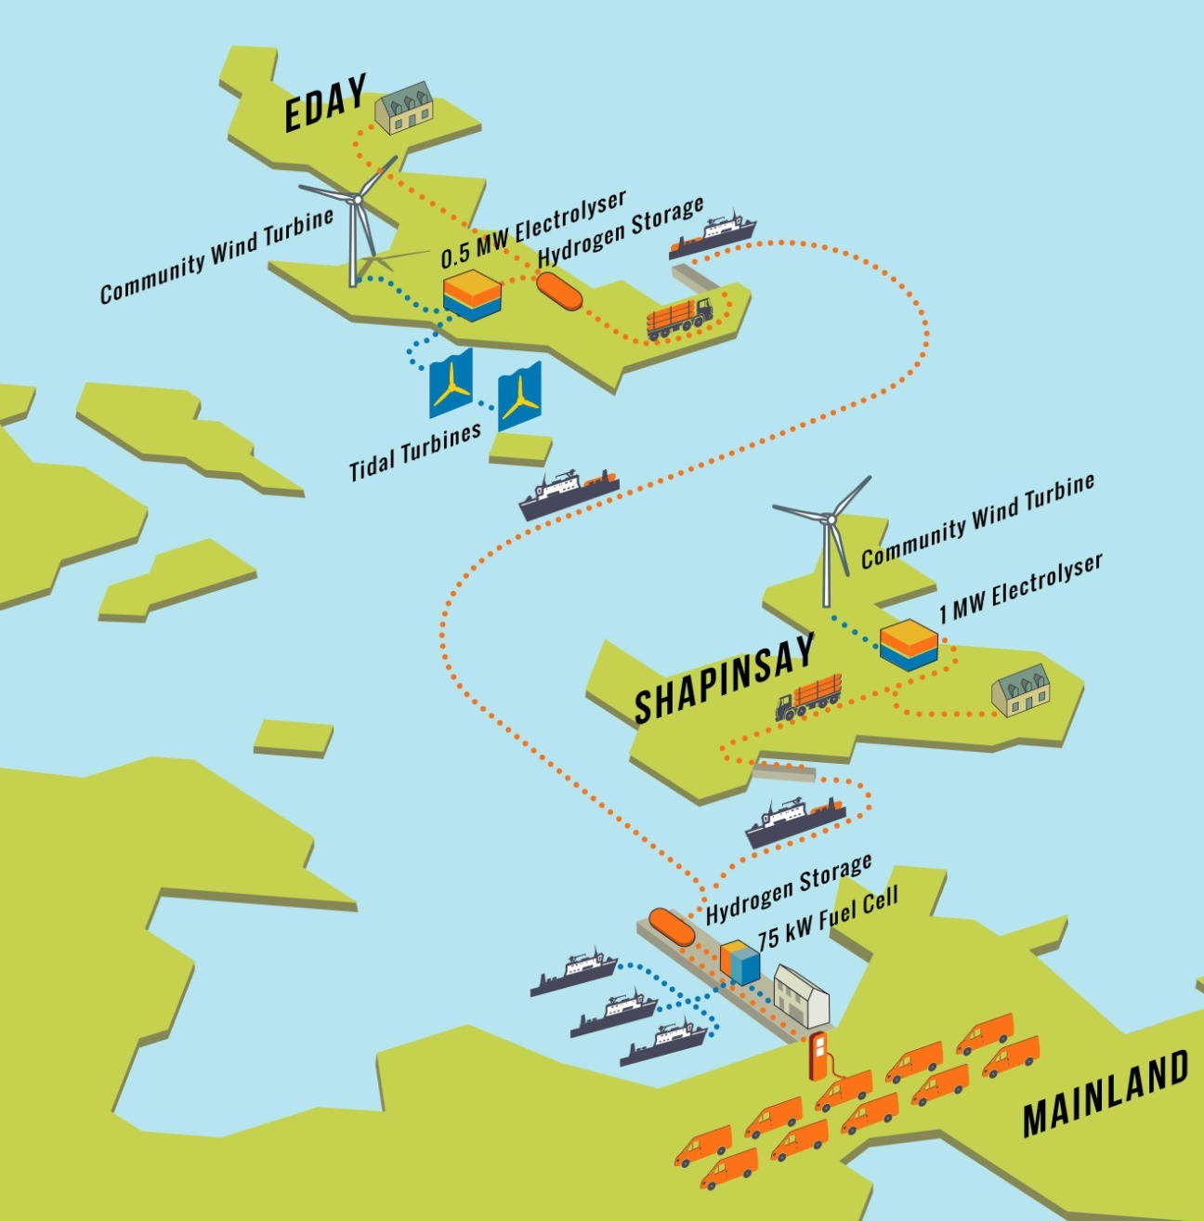
The BIG HIT Plan
Existing hydrogen infrastructure EMEC 0.5MW electrolyser,
3x tube trailers and 75kW fuel cell powering Kirkwall harbour
Add: 1MW electrolyser on Shapinsay H₂ heating for council buildings 2x tube trailers H₂ refuelling station 10 fuel cell vehicles in Kirkwall
EC-funded, operational for 4 years Followed by commercial operation as Orkney Hydrogen Trading
BIG HIT

Slide 22
DUAL Ports
Objective:
To allow the future refuelling of hydrogen ships
Achieved by:
Designing the first hydrogen ‘bunkering’ facility
Partnering with OIC and Orkney College
Working with the Maritime & Coastguard Agency to ensure their new regulations are in line with design
DUAL Ports
Notes:
Mention only.

Slide 23
HySeas:
Objective:
Respond to Scottish Government enthusiasm for world first hydrogen ro-ro
HySeas I – Investigate feasibility and design
HySeas II – Propulsion systems testing
HySeas III – Consortium (Scotland, Denmark, Norway, EC) to achieve funding for new vessel
We are working hard to bring to Orkney – massive demand for H₂ and hence power
HySeas

Slide 24
Ian Garman
Community Energy Scotland
ian.garman@communityenergyscotland.org.uk

