Slide 1
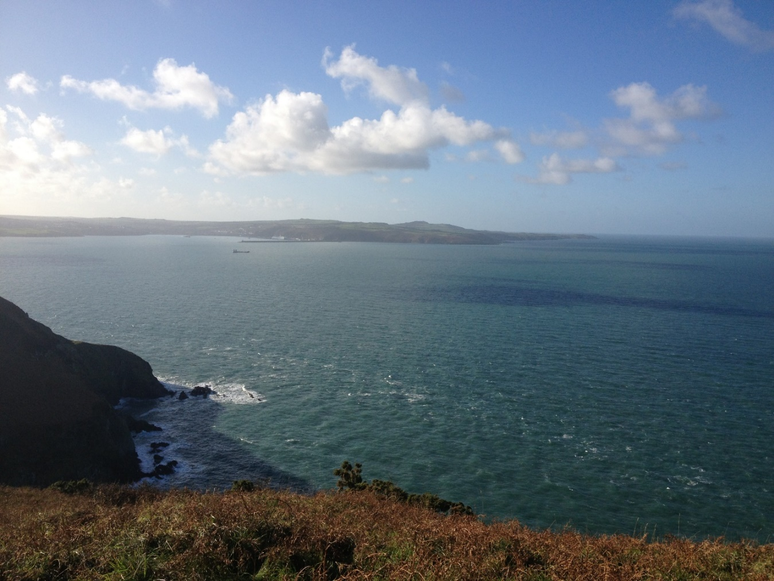
TBG Tidal Energy Project

Slide 2
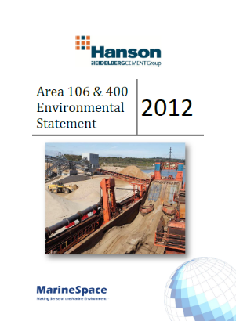
Marine EIA Process
Environmental Impact Assessment (EIA) required to accompany consent applications for certain marine developments, including tidal energy
EIA required in order to comply with certain UK and EU legislation
Relatively prescribed process - required to assess all potential impacts but some may be “Scoped Out”
End product of the EIA process is an Environmental Statement (ES)
This is the document submitted alongside consent/planning application to Licensing Authorities

Slide 3
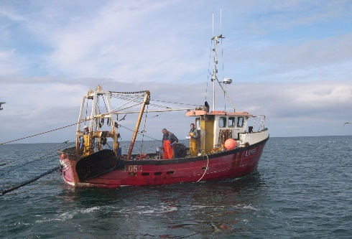
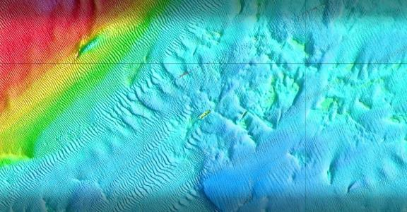
Marine EIA Process
Characterisation Surveys
Scope, type, specification agreed with key stakeholders (NRW)
Objective is provide information to characterise the project study area
Typical surveys
physical (i.e. MBES/SSS)
ecological (i.e. grab/DDV survey; bird/MM surveys
human (i.e. marine traffic)

Slide 4
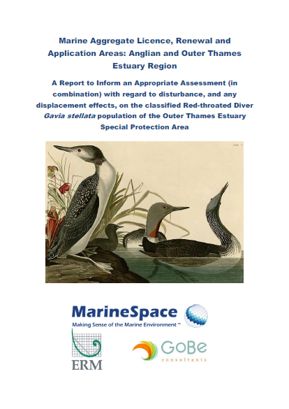
Marine EIA Process
Impact Assessment
Potential impacts identified and assessed using standard EIA methodologies
In areas of nature conservation interest (SAC/SPA), information provided that also enables Habitats Regulation Assessment (HRA) to be undertaken
Significance of impacts presented
Where adverse impacts predicted, mitigation measures proposed

Slide 5
Marine EIA Process
Mitigation & Monitoring
Presented in ES, but then transposed into eventual consent/planning permission
Can include limiting offshore works at times of years for certain locations
Can require use of soft-start/MMMPs
Restriction on type of cable installation
Use of FLOs and NTMs

Slide 6
Marine EIA Process
Consent Compliance
Large range of documents and reports need to be submitted prior to construction commencing
Include decommissioning plans, monitoring plans, pollution contingency plans etc…

Slide 7
Marine EIA Process
Construction & Operational Phase Monitoring
Typically during and for at least 3 years post-construction
Can include bird, marine mammal, ecology, fisheries surveys
Compared to pre-construction baselines
If impacts not in line with predictions of EIA, monitoring may be extended

